Slide 1
What is Collection
The Java Collections Framework is a collection of interfaces and classes which helps in storing and processing the data efficiently .
A collection is an object that represents a group of objects.
Collection has in 4 basic flavors as below,
Lists:
The List interface extends Collection to define an ordered collection with duplicates allowed. The List interface adds position-oriented operations, as well as a new list iterator that enables the user to traverse the list bi-directionally.
ArrayList,
LinkedList
and vector are classes implementing List interface.
2. Sets: The Set interface extends the Collection interface. It will make sure that an instance of Set contains no duplicate elements. The concrete class implements hashcode and equals methods to make sure uniqueness of objects.
Three concrete classes of Set are
HashSet,
LinkedHashSet
and TreeSet.
2. Maps: A map is a container that stores the elements along with the keys. The keys are like indexes. In List, the indexes are integers. In Map, the keys can be any objects. A map cannot contain duplicate keys. Each key maps to one value. A key and its corresponding value from an entry, which is actually stored in a map.
HashMap,
HashTable,
TreeMap
and LinkedHashMap are classes implementing Map interface.
4. Queues: A queue is a first-in, first-out data structure. Elements are appended to the end of the queue and are removed from the beginning of the queue. In a priority queue, elements are assigned priorities. When accessing elements, the element with the highest priority is removed first.

Slide 2
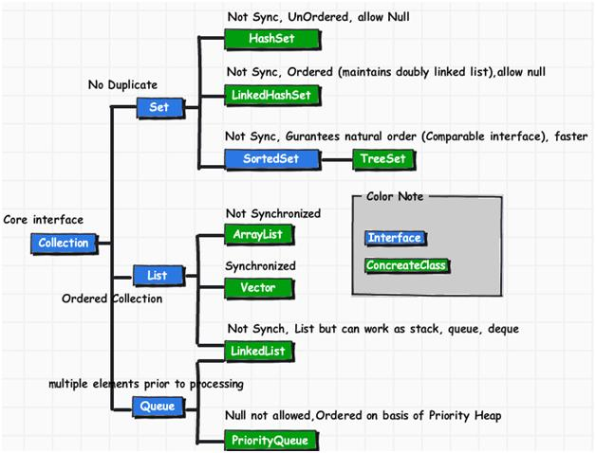
Collection Diagram

Slide 3
LIST
ArrayList and LinkedList both implements List interface and their methods and results are almost identical. However there are few differences between them which make one better over another depending on the requirement.
When to use LinkedList and when to use ArrayList?
1) Insert and remove operations give good performance in LinkedList compared to ArrayList. Hence if there is a requirement of frequent addition and deletion in application then LinkedList is a best choice.
2) Search (get method) operations are fast in Arraylist but not in LinkedList so If there are less add and remove operations and more search operations requirement, ArrayList would be your best bet.
ArrayList | LinkedList
1) ArrayList internally uses dynamic array to store the elements. | LinkedList internally uses doubly linked list to store the elements.
2) Manipulation with ArrayList is slow because it internally uses array. If any element is removed from the array, all the bits are shifted in memory. | Manipulation with LinkedList is faster than ArrayList because it uses doubly linked list so no bit shifting is required in memory.
3) ArrayList class can act as a list only because it implements List only. | LinkedList class can act as a list and queue both because it implements List and Deque interfaces.
4) ArrayList is better for storing and accessing data. | LinkedList is better for manipulating data.

Slide 4
SET
HASHSET | HASHMAP
HashSet class implements the Set interface | HashMap class implements the Map interface
In HashSet we store objects(elements or values) e.g. If we have a HashSet of string elements then it could depict a set of HashSet elements: {“Hello”, “Hi”, “Bye”, “Run”} | HashMap is used for storing key & value pairs. In short it maintains the mapping of key & value (The HashMap class is roughly equivalent to Hashtable, except that it is unsynchronized and permits nulls.) This is how you could represent HashMap elements if it has integer key and value of String type: e.g. {1->”Hello”, 2->”Hi”, 3->”Bye”, 4->”Run”}
HashSet does not allow duplicate elements that means you can not store duplicate values in HashSet. | HashMap does not allow duplicate keys however it allows to have duplicate values.
HashSet permits to have a single null value. | HashMap permits single null key and any number of null values.

